Slide 1
Chapter 9: Introduction to PKI
Instructor-led overview and operational guidance

Slide 2
Chapter Topics
01 9.1 Applications
02 9.2 Algorithms
03 9.3 Certificate management
04 9.4 Installing and enabling OpenSSH Server
05 9.5 Configuring SSH for remote administration
06 9.6 Managing key-based authentication on Windows Server
Windows Server 2025 | Chapter 9 | Introduction to PKI
03

Slide 3
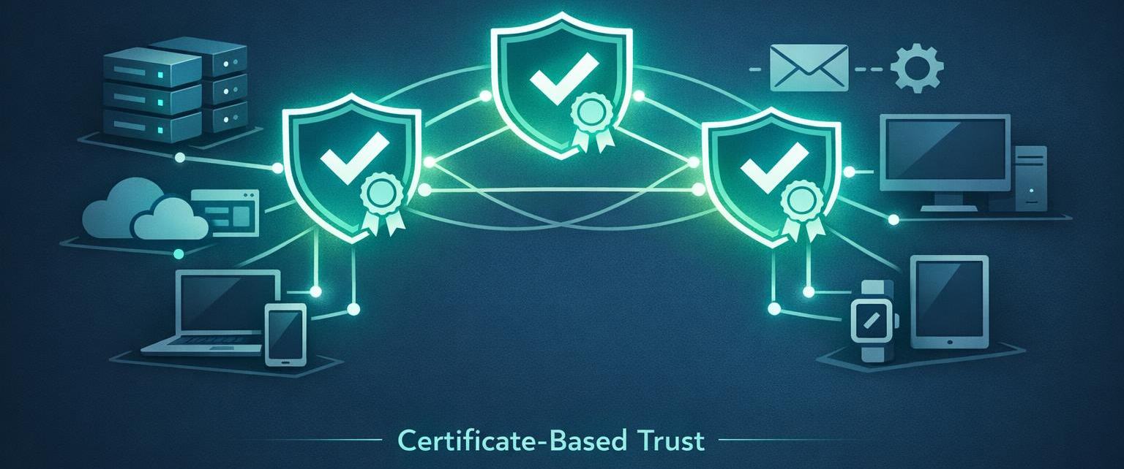
9.1 Applications
In the PKI context, applications refers to the workloads and trust-dependent services that rely on certificates and public key infrastructure.
Certificate-backed trust relationships
Server and client authentication uses
Role and application integration
Windows Server 2025 | Chapter 9 | Introduction to PKI
04

Slide 4

9.2 Algorithms
Algorithms in PKI describe the cryptographic methods used for key exchange, signing, hashing, and related security operations.
Asymmetric and symmetric roles
Hashing and signing relationships
Administrative impact of algorithm choice
Windows Server 2025 | Chapter 9 | Introduction to PKI
05

Slide 5
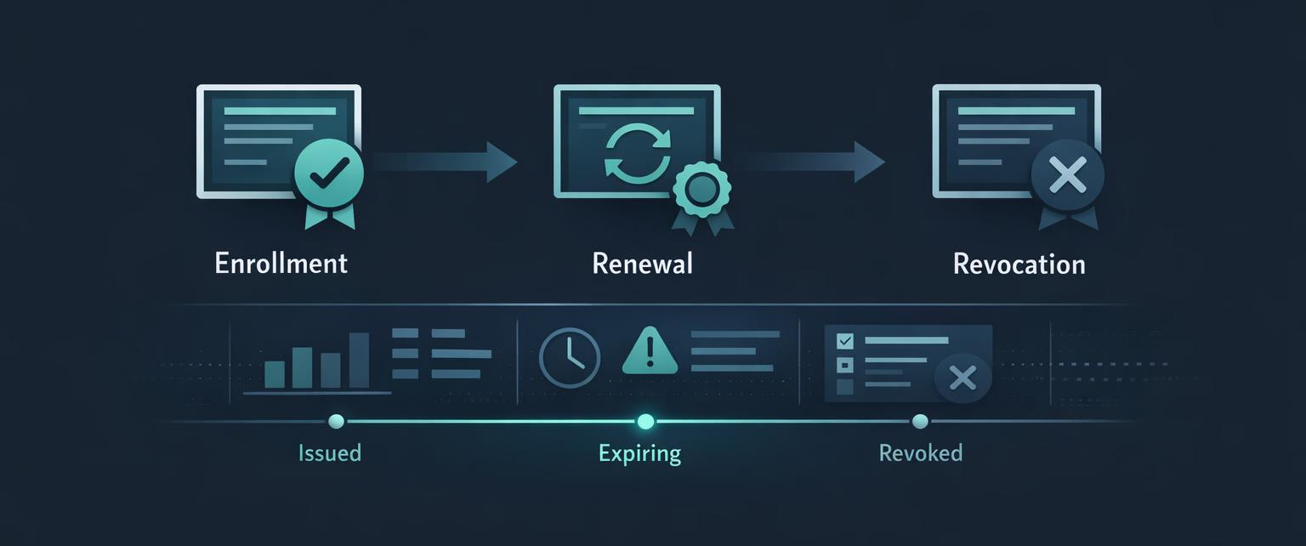
9.3 Certificate management
Certificate management covers enrollment, storage, renewal, trust, and operational handling of certificates in Windows environments.
Certificate stores and trust paths
Enrollment and lifecycle activities
Operational monitoring and renewal
Windows Server 2025 | Chapter 9 | Introduction to PKI
06

Slide 6
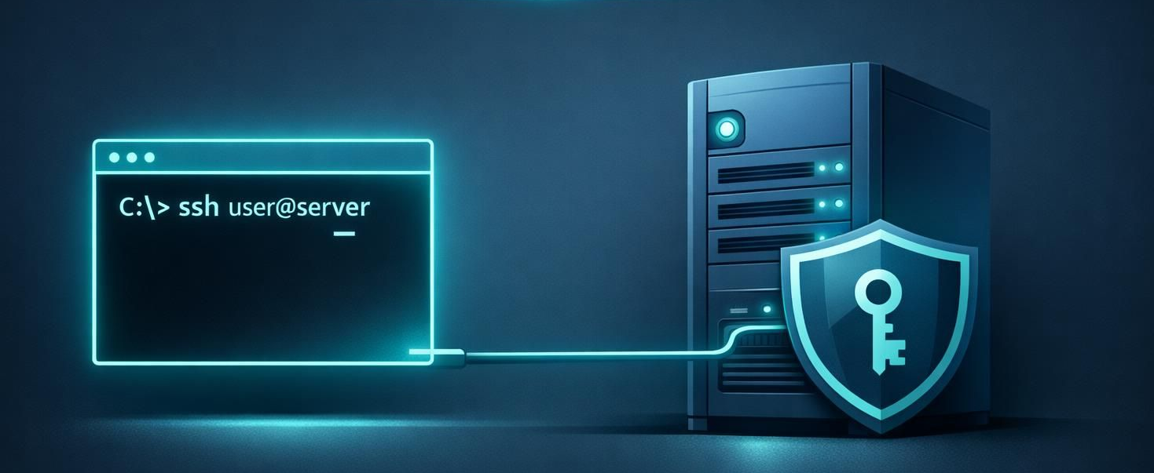
9.4 Installing and enabling OpenSSH Server
Installing and enabling OpenSSH Server adds SSH-based remote management capability to Windows Server.
OpenSSH Server capability
Service enablement and startup
Firewall and administrative access
Windows Server 2025 | Chapter 9 | Introduction to PKI

Slide 7

9.5 Configuring SSH for remote administration
Configuring SSH for remote administration means adjusting the OpenSSH service and settings so Windows Server can be administered securely over SSH.
sshd configuration file
Firewall and service behavior
User and shell access model
Windows Server 2025 | Chapter 9 | Introduction to PKI
08

Slide 8
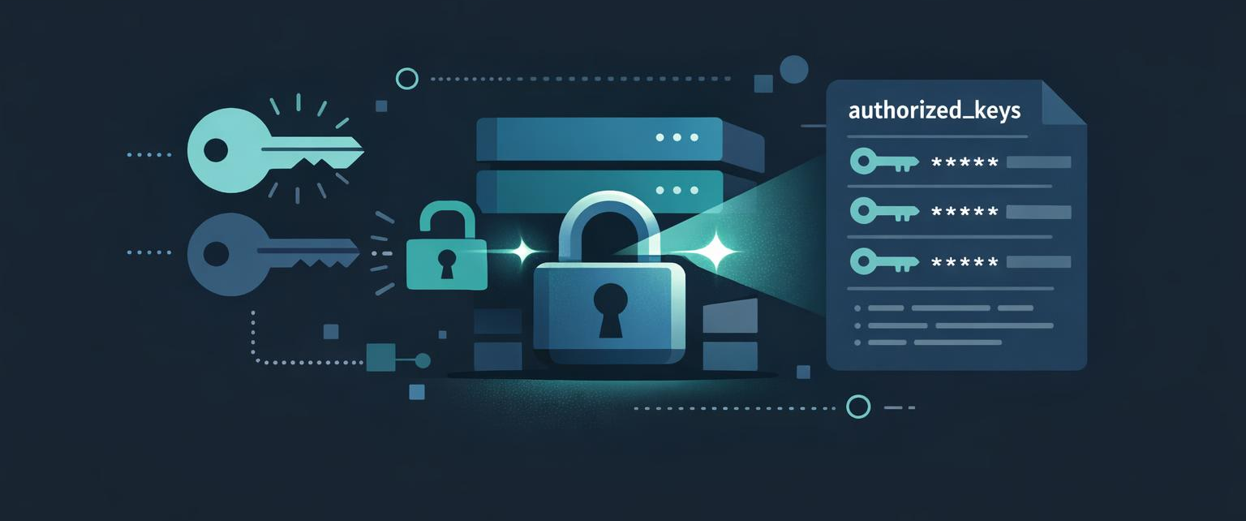
9.6 Managing key-based authentication on Windows Server
Key-based authentication allows administrators to use SSH keys instead of passwords for OpenSSH access on Windows Server.
Authorized keys storage
User or admin key placement
Credential hygiene and operational control
Windows Server 2025 | Chapter 9 | Introduction to PKI
09

Slide 9
What is PKI? Concepts and the Trust Chain
CA Trust Hierarchy
What is PKI?
Public Key Infrastructure (PKI) — a system of digital certificates, Certificate Authorities (CAs), and policies that enable trusted communication and identity verification
Built on asymmetric cryptography: a public key (shareable) and private key (secret) are mathematically linked — what one encrypts, only the other can decrypt or verify
A certificate binds a public key to an identity (server name, user, device) and is signed by a trusted CA — that signature is how trust is established
Certificates carry: Subject name, Subject Alternative Names (SANs), issuing CA, validity dates, public key, key usage, and the CA's digital signature
How Chain Validation Works
When a client receives a certificate it validates: (1) the CA signature is genuine, (2) the chain leads to a trusted Root CA in its trust store, (3) the cert is not expired or revoked, (4) the name matches
If any step fails — wrong name, expired, untrusted issuer, revoked — the connection is rejected
▼ Root CA (Offline)
Self-signed. Kept offline. Trusted by all.
▼ Issuing CA (Online)
Signed by Root CA. Issues end-entity certs.
Server Cert
User Cert
Code Sign
Two-tier hierarchy — most enterprise deployments
Windows Server 2025 | Chapter 9 | Introduction to PKI
10

Slide 10
Standalone vs Enterprise
Standalone CA
Enterprise CA
Must be used if any CA (root, intermediate, or policy) is offline, since a standalone CA is not joined to an AD DS domain
Users must provide identifying information and specify the type of certificate
Does not support certificate templates
All certificate requests are kept pending until administrator approval
Requires the use of AD DS and stores information in AD DS
Can use Group Policy to propagate certificates to the trusted root CA certificate store
Publishes user certificates and CRLs to AD DS
Issues certificates based on a certificate template
Supports autoenrollment for issuing certificates

Slide 11
PKI Use Cases in Windows Server
Where Windows Uses PKI
Every certificate-dependent service relies on a trusted CA issuing the cert
AD CS integrates with AD DS — auto-enrolment via Group Policy
Authentication
Smart card logon replaces password with private key proof
NPS / 802.1X validates machine certs before granting network access
RDP uses machine certs to prevent man-in-the-middle
Encryption & Integrity
EFS: per-file encryption tied to user certificate
S/MIME: digitally sign and encrypt email end-to-end
IPsec/VPN: cert auth removes shared-secret risk
Trust & Compliance
Code signing verifies script/driver origin — required for Secure Boot
Web server certs (IIS) establish HTTPS — mandatory for modern browsers
HTTPS / TLS
Web servers, IIS, RDS
Smart Card Auth
Logon with cert on card
RDP / NPS
Machine certs for RDP & 802.1X
EFS
Encrypting File System keys
VPN / IPsec
Machine/user cert auth
S/MIME Email
Sign & encrypt Outlook mail
Code Signing
Sign scripts & drivers
AD CS Templates
Automate cert issuance via GPO
Windows Server 2025 | Chapter 9 | Introduction to PKI
11

Slide 12
Cryptographic Algorithms in Windows Server
Asymmetric (Public Key) Algorithms
RSA — 2048-bit minimum; used in TLS handshake, cert signing, key exchange
Windows Server 2025: RSA-3072/4096 recommended for new CAs
ECDSA (P-256, P-384) — smaller key, equivalent strength; preferred for modern TLS
Faster than RSA; supported in AD CS, IIS, and smart card certs
EdDSA (Ed25519) — used by OpenSSH on Windows Server 2025
Fixed 256-bit key; resistant to side-channel attacks
Symmetric (Bulk Encryption)
AES-128 / AES-256 — standard for BitLocker, EFS, IPsec, TLS session data
ChaCha20-Poly1305 — TLS 1.3 cipher suite; hardware-agnostic performance
Hashing & Integrity
SHA-256 / SHA-384 — required for code signing, cert digests, TLS 1.2+
HMAC-SHA256 — message authentication codes in Kerberos, IPsec
Deprecated — Do Not Use
MD5 — collision-broken; still seen in old NTLM; disabled in WS2025 by default
SHA-1 — deprecated since 2017; browsers reject SHA-1 certs
RC4 — stream cipher; disabled in Windows Server 2022+
DES / 3DES — prohibited in TLS 1.3; legacy Kerberos only
Windows CNG (Cryptography Next Generation)
CNG is the modern Windows crypto API — replaces CryptoAPI (CAPI)
All Windows Server 2025 roles use CNG providers
Algorithm agility: swap algorithms without changing application code
FIPS 140-2/3 validated modules available via CNG
TLS Protocol Versions
TLS 1.3 — default in WS2025; mandatory Perfect Forward Secrecy
TLS 1.2 — still supported for compatibility
TLS 1.0 / 1.1, SSL 3.0 — disabled by default in WS2025
Windows Server 2025 | Chapter 9 | Introduction to PKI
12

Slide 13
Windows Certificate Stores
Certificate Store Hierarchy
Local Machine Store
certlm.msc — Computer certs
Sub-stores:
Personal, Trusted Root CA
Intermediate CA, Trusted People
Enterprise Trust, Smart Card
View & Manage Stores — PowerShell
# List all certs in LocalMachine\My
Get-ChildItem Cert:\LocalMachine\My
# Find expiring certs (next 30 days)
$exp = (Get-Date).AddDays(30)
Get-ChildItem Cert:\LocalMachine\My |
Where NotAfter -lt \$exp
# Export cert to PFX (with private key)
Export-PfxCertificate -Cert \
Cert:\LocalMachine\My\<thumb> \
-FilePath C:\export\server.pfx \
-Password (Read-Host -AsSecureString)
# Import a PFX
Import-PfxCertificate -FilePath C:\cert.pfx \
-CertStoreLocation Cert:\LocalMachine\My
# Remove expired certs
Get-ChildItem Cert:\LocalMachine\My |
Where NotAfter -lt (Get-Date) |
Remove-Item
GUI Tools
certlm.msc — Local Machine store (admin required)
certmgr.msc — Current User store
MMC + Certificates snap-in — for service accounts
Current User Store
certmgr.msc — User certs
Sub-stores:
Personal (My), Root CAs
Intermediate CAs
Certificate Enrolment Requests
Service Account Store
Per-service isolated store
Sub-stores:
Isolated per Windows service
e.g. IIS app pool identity
Managed via certlm.msc
Windows Server 2025 | Chapter 9 | Introduction to PKI
13

Slide 14
Certificate Lifecycle & AD CS
1. Request
CSR generated · by client
2. Issuance
CA signs cert · from template
3. Renewal
Auto-enrol via · Group Policy
4. Revocation
CRL / OCSP · revoke bad certs
5. Archive
Private key · archeived by CA
Auto-Enrolment via Group Policy
# Enable auto-enrolment in GPO:
# Computer Config → Policies →
# Windows Settings → Security →
# Public Key Policies →
# Certificate Services Client
Revocation — CRL & OCSP
CRL — delta CRL published hourly; base CRL weekly
OCSP — Online Responder replies in seconds; preferred for high-traffic
# Revoke a cert (CA admin)
Revoke-CACertificate -SerialNumber \
'1f2e3d' -Reason 'KeyCompromise'
# Force CRL publish
Publish-CRLDistributionPoint
Install AD CS Role
Install-WindowsFeature ADCS-Cert-Authority \
-IncludeManagementTools
Install-AdcsCertificationAuthority \
-CAType EnterpriseRootCa \
-CryptoProviderName 'RSA#KSP' \
-KeyLength 4096 -HashAlgorithmName SHA256
AD CS Role Components
Certification Authority (CA) — issues and signs certificates
Certificate Enrolment Policy Web Service — policy delivery over HTTPS
Certificate Enrolment Web Service — enrolment for non-domain clients
Online Responder (OCSP) — real-time revocation status; replaces CRL polling
Network Device Enrolment Service (NDES) — SCEP for network devices
Certificate Templates
Templates define: key usage, subject name, validity, auto-enrolment
Version 2/3 templates support auto-enrolment and key archival
Duplicate built-in templates — never modify originals directly
Windows Server 2025 | Chapter 9 | Introduction to PKI
14

Slide 15

OpenSSH

Slide 16
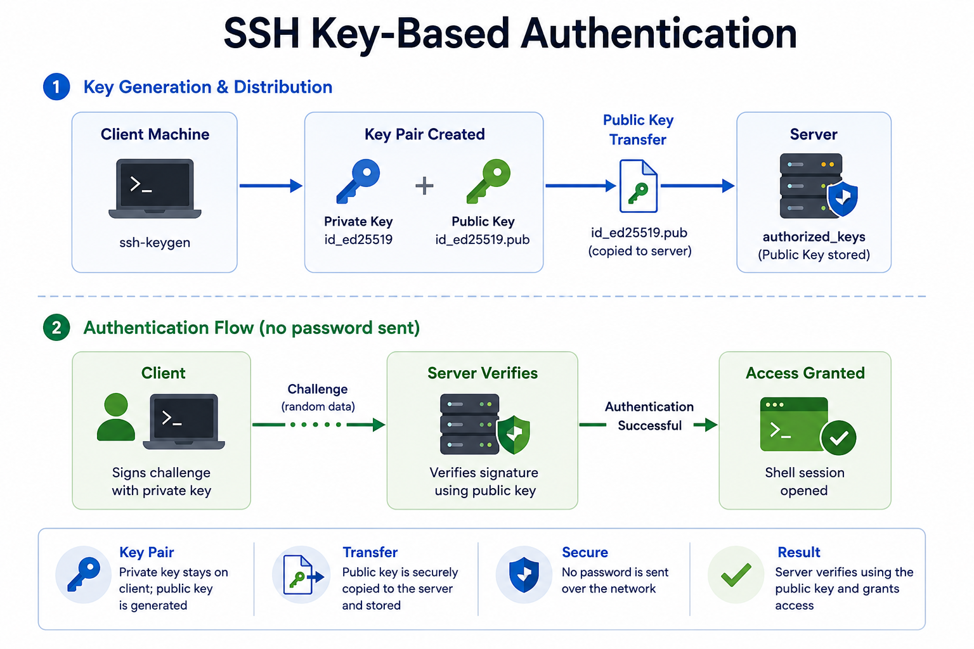

Slide 17
OpenSSH on Windows Server: Installation & Configuration
Install OpenSSH
# Check available packages
Get-WindowsCapability -Online | Where Name -like 'OpenSSH*'
# Install server and client
Add-WindowsCapability -Online \
-Name OpenSSH.Server~~~~0.0.1.0
Add-WindowsCapability -Online \
-Name OpenSSH.Client~~~~0.0.1.0
# Start and auto-start the service
Start-Service sshd
Set-Service sshd -StartupType Automatic
# Allow through Windows Firewall
New-NetFirewallRule -Name 'OpenSSH-Server' \
-DisplayName 'OpenSSH Server (sshd)' \
-Protocol TCP -LocalPort 22 \
-Action Allow -Direction Inbound
Default Paths
Binary: %SystemRoot%\System32\OpenSSH\
Config: %ProgramData%\ssh\sshd_config
Host keys: %ProgramData%\ssh\ssh_host_*_key
Logs: Event Viewer → Applications → OpenSSH
Key sshd_config Settings
# C:\ProgramData\ssh\sshd_config
Port 22
PermitRootLogin no
PasswordAuthentication yes
PubkeyAuthentication yes
AuthorizedKeysFile .ssh/authorized_keys
# Restrict to specific AD group
AllowGroups 'CONTOSO\SSH-Admins'
# Admin users: keys go here instead
Match Group administrators
AuthorizedKeysFile __PROGRAMDATA__/ssh/administrators_authorized_keys
# Disable weak ciphers
Ciphers aes256-gcm@openssh.com,aes128-gcm@openssh.com
MACs hmac-sha2-512,hmac-sha2-256
KexAlgorithms curve25519-sha256
Reload After Changes
Restart-Service sshd
Key Difference — Admin vs Standard Users
Standard users: keys in %USERPROFILE%\.ssh\authorized_keys
Administrators group: keys in %ProgramData%\ssh\administrators_authorized_keys
The admin path must have ACL: SYSTEM and Administrators only (not user-writable)
Windows Server 2025 | Chapter 9 | Introduction to PKI
15

Slide 18

SSH Key-Based Authentication
Generate Key Pair (on client)
# Ed25519 (recommended)
ssh-keygen -t ed25519 -C 'admin@contoso'
# RSA 4096-bit (compatibility)
ssh-keygen -t rsa -b 4096
Copy Public Key to Server
# From Linux/macOS client:
ssh-copy-id admin@lon-srv1.contoso.com
# Windows PowerShell:
$k = Get-Content ~/.ssh/id_ed25519.pub
ssh admin@lon-srv1 'mkdir -Force ~/.ssh;
Add-Content ~/.ssh/authorized_keys $k'
Disable Password Auth (hardening)
# sshd_config:
PasswordAuthentication no
ChallengeResponseAuthentication no
Restart-Service sshd
Why Key Auth?
Private key never transmitted — nothing to intercept
Ed25519: 256-bit, faster than RSA-4096, side-channel resistant
Passphrase on key = passwordless MFA without extra infra
Windows Server 2025 | Chapter 9 | Introduction to PKI
16

Slide 19
Chapter Summary
01 Introduce PKI as an administrative trust system rather than as abstract cryptography
02 Keep algorithms practical and operations-focused
03 Show how OpenSSH fits into modern server management alongside Windows-native tools
04 Reinforce repeatable administration, validation, and supportable design choices
Windows Server 2025 | Chapter 9 | Introduction to PKI
18

Slide 20
Knowledge Check
1
What is the main administrative purpose of Applications?
2
What is the main administrative purpose of Algorithms?
3
What is the main administrative purpose of Certificate management?
4
What is the main administrative purpose of Installing and enabling OpenSSH Server?
Windows Server 2025 | Chapter 9 | Introduction to PKI
19

Slide 21
PRACTICE LAB
Lab 0901
Installing OpenSSH and Configuring Secure Remote Access
In this lab, you will install and configure OpenSSH Server on Windows Server, enabling secure SSH connections as an alternative to RDP. You will generate SSH keys and configure key-based authentication for secure remote access.
Windows Server 2025 | Chapter 9 | Introduction to PKI
20

